Slide 1
Medical Literature Review & Compliance Engine
Problem Statement
🚨 Problem Statement: The Clinical Protocol Bottleneck
The Core Challenge
Pharmaceutical sponsors, Contract Research Organizations (CROs), and Institutional Review Boards (IRBs) face massive administrative friction and safety risks when evaluating clinical trial protocols against ever-evolving global regulatory and pharmaceutical safety standards.
Key Industry Statistics & Critical Hazards
💰 $1.5M–$8M Average financial loss per day for delayed, suspended, or rejected Phase II/III clinical trials.
⚠️ >50mg Cardiotoxicity Thresholds: Doses exceeding baseline parameters cause severe cardiac complications if telemetry monitoring is missing.
🧬 30% Adverse Event Spike: Specific combination therapies (e.g., Alpha-1 + Beta-2 inhibitors) significantly increase adverse patient events.
⏱️ 4 to 12 Weeks: Average manual review time required for human IRB committees to audit cross-referenced protocol documentation.

Slide 2
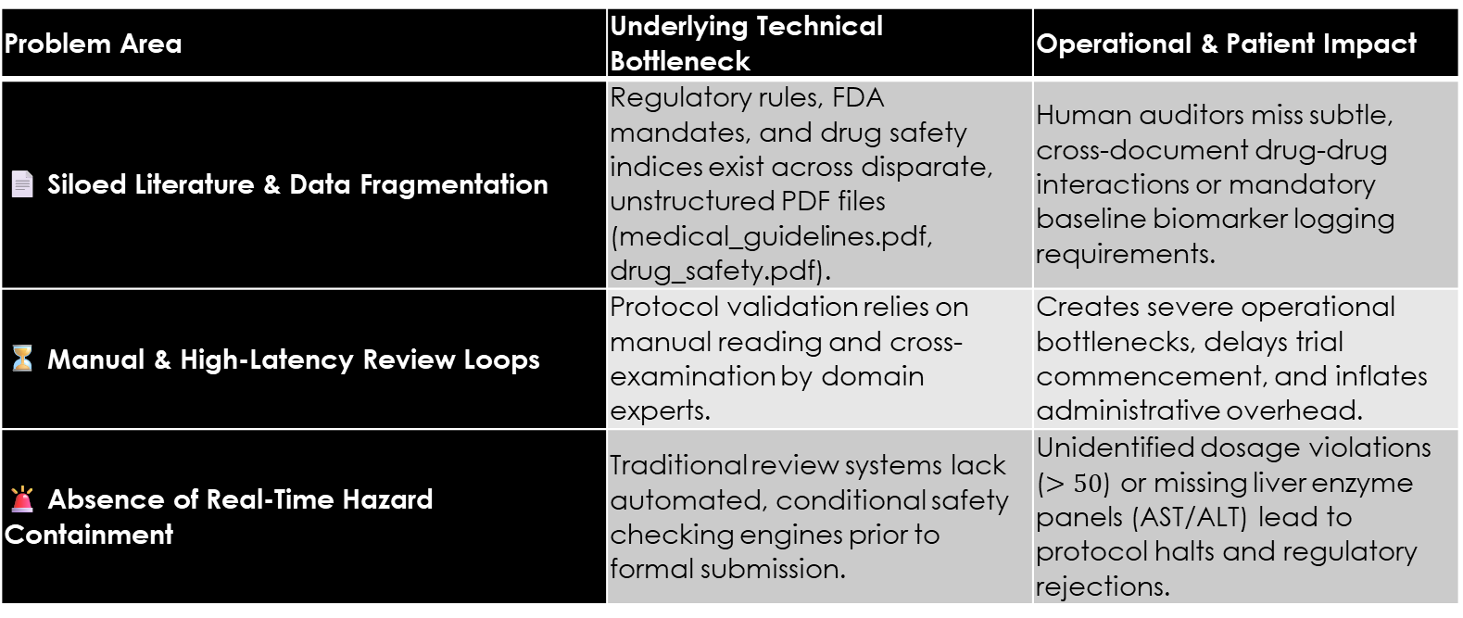
In-Depth Analysis of Core Bottlenecks
Problem Area | Underlying Technical Bottleneck | Operational & Patient Impact
📄 Siloed Literature & Data Fragmentation | Regulatory rules, FDA mandates, and drug safety indices exist across disparate, unstructured PDF files (medical_guidelines.pdf, drug_safety.pdf). | Human auditors miss subtle, cross-document drug-drug interactions or mandatory baseline biomarker logging requirements.
⏳ Manual & High-Latency Review Loops | Protocol validation relies on manual reading and cross-examination by domain experts. | Creates severe operational bottlenecks, delays trial commencement, and inflates administrative overhead.
🚨 Absence of Real-Time Hazard Containment | Traditional review systems lack automated, conditional safety checking engines prior to formal submission. | Unidentified dosage violations ($>50$) or missing liver enzyme panels (AST/ALT) lead to protocol halts and regulatory rejections.

Slide 3
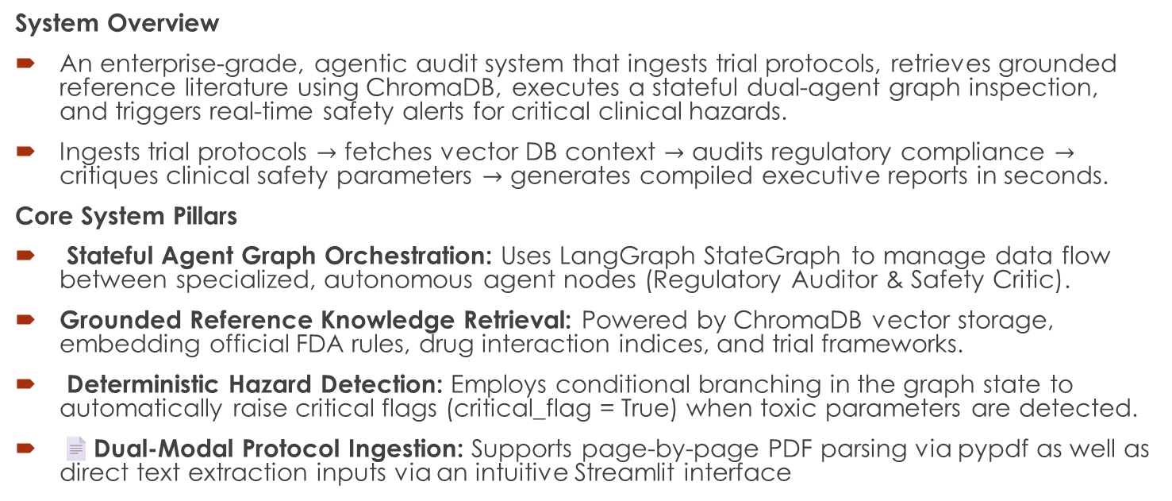
💡 Solution: Multi-Agent Compliance Engine
System Overview
An enterprise-grade, agentic audit system that ingests trial protocols, retrieves grounded reference literature using ChromaDB, executes a stateful dual-agent graph inspection, and triggers real-time safety alerts for critical clinical hazards.
Ingests trial protocols $→$ fetches vector DB context $→$ audits regulatory compliance $→$ critiques clinical safety parameters $→$ generates compiled executive reports in seconds.
Core System Pillars
Stateful Agent Graph Orchestration: Uses LangGraph StateGraph to manage data flow between specialized, autonomous agent nodes (Regulatory Auditor & Safety Critic).
Grounded Reference Knowledge Retrieval: Powered by ChromaDB vector storage, embedding official FDA rules, drug interaction indices, and trial frameworks.
Deterministic Hazard Detection: Employs conditional branching in the graph state to automatically raise critical flags (critical_flag = True) when toxic parameters are detected.
📄Dual-Modal Protocol Ingestion: Supports page-by-page PDF parsing via pypdf as well as direct text extraction inputs via an intuitive Streamlit interface

Slide 4
🏗️ Technical Architecture & Workflow Pipeline
End-to-End System Graph Pipeline
[ Input Protocol ] ---> [ Document Parser ] ---> [ Vector DB (Chroma) ]
| | |
v v v
(PDF / Text Input) (pypdf / Streamlit) (k=3 RAG Context Retrieval)
|
v
[ StateGraph Execution ] <----------------------------------+
|
+---> Node 1: Regulatory Auditor Agent ---> Updates 'audit_findings'
| |
+---> Node 2: Safety Critic Agent ---> Updates 'safety_critique' & 'critical_flag'
|
v
[ Executive Audit Dashboard ]
(Live Findings

Slide 5
AI Agents
📋 AG01: Regulatory Auditor Agent
Role & Objective: Acts as an expert clinical regulatory auditor to cross-examine submitted trial protocols against established medical guidelines and FDA mandates.
Input Context: Reads initial_state["protocol"] alongside retrieved initial_state["context"] from ChromaDB.
Key Tasks Executed:
Verifies baseline biomarker requirements (e.g., FDA Rule 2026: Day 0 pre-injection and Day 14 post-injection mRNA tracking).
Checks for mandatory laboratory schedules (e.g., Standard Protocol 88: Weekly AST/ALT liver enzyme panels).
Identifies regulatory omissions or missing audit trails in trial abstracts.

Slide 6
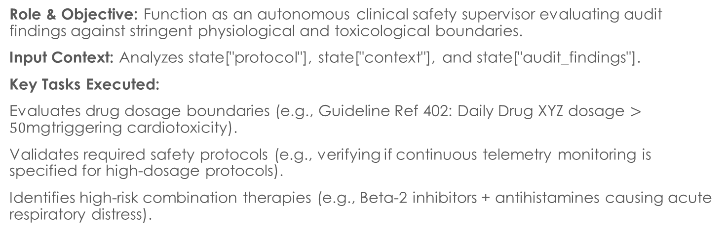
AG02: Safety Critic Agent
Role & Objective: Function as an autonomous clinical safety supervisor evaluating audit findings against stringent physiological and toxicological boundaries.
Input Context: Analyzes state["protocol"], state["context"], and state["audit_findings"].
Key Tasks Executed:
Evaluates drug dosage boundaries (e.g., Guideline Ref 402: Daily Drug XYZ dosage $>50\text{mg}$triggering cardiotoxicity).
Validates required safety protocols (e.g., verifying if continuous telemetry monitoring is specified for high-dosage protocols).
Identifies high-risk combination therapies (e.g., Beta-2 inhibitors + antihistamines causing acute respiratory distress).

Slide 7
1.medical_guidelines.pdf (Global Standards & FDA Mandates)
2. drug_safety.pdf (Pharmaceutical Interactions Index)
3. clinical_trial.pdf (Framework & Blueprint Templates)

Slide 8
Key Technical Differentiators and Future Scopes
Real-Time Conditional Hazard Flags.
🛠️ Automated Self-Healing Deployment Wrapper
Future Technical Roadmap
[ Phase 1: MVP & Graph Engine ] --------> [ Phase 2: Enterprise Integration ] --------> [ Phase 3: Scale ]
(Current) (6–12 months) (12–24 months)
Phase 1: MVP & Core Graph Engine (Current)
Completed LangGraph state machine, ChromaDB vector retrieval, dual PDF/text ingestion, and real-time hazard flagging.
Phase 2: Enterprise CTMS & EHR Integration (6–12 Months)
Seamless integration with Clinical Trial Management Systems (CTMS) and electronic submission portals (e.g., FDA ESG).
Expansion of vector knowledge bases to cover multi-region regulatory bodies (EMA, PMDA, CDSCO).
Automated fine-tuning of domain-specific LLM adapters for specialized therapeutic areas (Oncology, Cardiology).
Phase 3: Automated Protocol Optimization & Scale (12–24 Months)
Auto-Remediation Engine: Suggests precise textual and dosage edits to resolve detected safety violations automatically.
Enterprise Multi-Tenant Deployment supporting real-time collaborative protocol editing for research teams.

